Slide 1
Back Tracking and Branch & Bound

Slide 2

Outline
Introduction
The Eight queens problem
Knapsack problem
Travelling Salesman problem
Minimax principle
Looping

Slide 3
Introduction

Slide 4
Backtracking
Backtracking can be defined as a general algorithmic technique that considers searching every possible combination in order to solve an optimization problem.
It is a recursive technique.
It generates state space tree for all possible solutions.
It traverse state space tree in the depth first order.
So, in a backtracking we attempt solving a sub-problem, and if we don't reach the desired solution, then undo whatever we did for solving that sub-problem, and try solving another sub-problem.
All the solutions require a set of constraints divided into two categories: explicit and implicit constraints.

Slide 5
Example
In how many ways we can arrange 2 boys and 1 girl in a seating arrangement of 3 chair.
S
CONSTRAINT : girl should not sit in between
Apply bounding condition to kill the node
B1
B2
G1
B2
G1
B1
G1
B1
B2
G1
B2
G1
B1
B2
B1

Slide 6
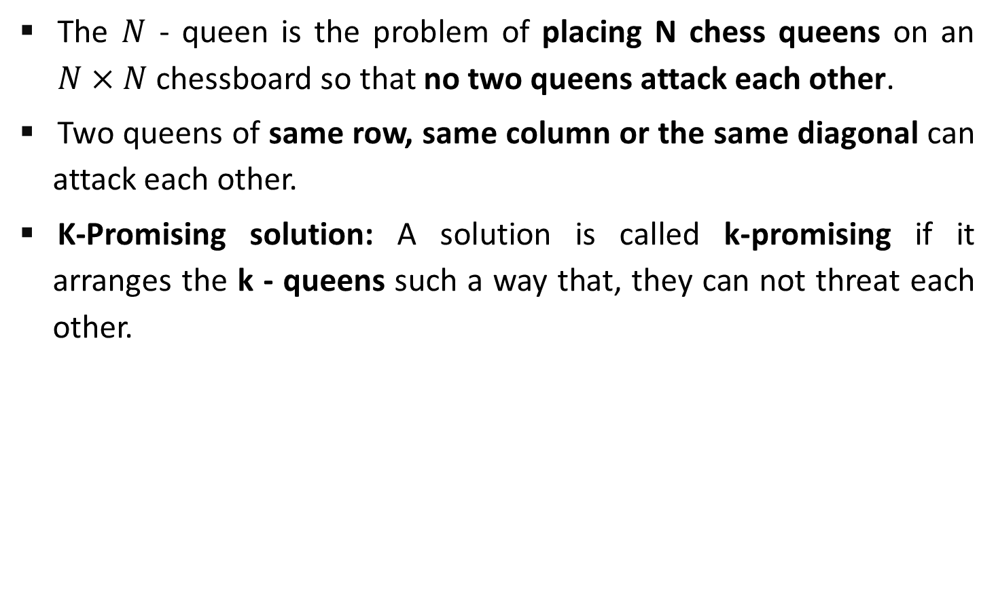
The N - Queens Problem
The $N$ - queen is the problem of placing N chess queens on an $N×N$ chessboard so that no two queens attack each other.
Two queens of same row, same column or the same diagonal can attack each other.
K-Promising solution: A solution is called k-promising if it arranges the k - queens such a way that, they can not threat each other.
Q
Q
Q
Q
 | Q
1 - Promising Solution
0 - Promising Solution
0 - Promising Solution
0 - Promising Solution

Slide 7
The 4 - queen Problem
C(16,4)
 | 1 | 2 | 3 | 4
 | Q
 | 1 | 2 | 3 | 4
 | Q
 | Q | Q | Q
 | Q | Q | Q | Q
 | 1 | 2 | 3 | 4
 |  |  | Q
 | Q
 | Q | Q | Q | Q
 | Q | Q
1 - Promising
2 - Promising
4 – Promising
<3, 1, 4, 2>
 | 1 | 2 | 3 | 4
1 |  | Q
2 |  |  |  | Q
3 | Q
4 |  |  | Q
Above 4-promising solution can be written as
<3, 1, 4, 2>
Another possible solution is
<2, 4, 1, 3>
4 – Promising <2, 4, 1, 3>

Slide 8
N - Queen Problem
Number of Queens | Possible Solutions
1 | 1
2 | 0
3 | 0
4 | 2
5 | 10
6 | 4
7 | 40
8 | 92
9 | 352
10 | 724

Slide 9
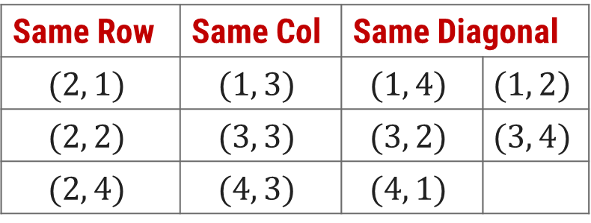


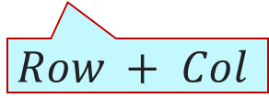
N - Queen Problem
Here, queen position is $(2, 3)$.
To identify the positions that can not be chosen, so that the queen does not attack.
The diagonal positions which are under attack are denoted as,
 | 1 | 2 | 3 | 4
1
2 |  |  | Q
3
4
Same Row | Same Col | Same Diagonal
$$(2, 1)$$ | $$(1, 3)$$ | $$(1, 4)$$ | $$(1, 2)$$
$$(2, 2)$$ | $$(3, 3)$$ | $$(3, 2)$$ | $$(3, 4)$$
$$(2, 4)$$ | $$(4, 3)$$ | $$(4, 1)$$
$$Row−Col$$
$$Row + Col$$

Slide 10
[2,4,0,0]
 | 1 | 2 | 3 | 4
1 |  | Q
2 |  |  |  | Q
3 | Q
4 |  |  | Q
Sol =
[2,4,1,0]
K =
[2,0,0,0]
1
3
[2,4,1,3]
4
2
col =
{2,4}
{2}
diag45 =
{2}
{2,3,-2}
{2,4,1}
{2,3}
diag135 =
{2,5}
{2}
{2,5,4}
procedure queens (k, col, diag45, diag135)
{sol[1..k] is k-promising,
col = {sol[i] | 1≤i≤k},
diag45 = {sol[i]–i+1 | 1≤i≤k}, and
diag135 = {sol[i]+i–1 | 1≤i≤k}}
if k = 4 then
write sol
else
for j ← 1 to 4 do
if j ∉ col and j – k ∉ diag45 and j + k ∉ diag135
then sol[k+1]← j
queens(k + 1, col U {j}, diag45 U {j - k}, diag135 U {j + k})
3- Promising
1- Promising
4- Promising
2- Promising
j = 1
j = 4
j = 2
j = 3
j = 1
J - k = 3
J - k = 2
J - k = 0
J + k = 3
J + k = 5
J - k = -1
J + k = 2

Slide 11
sol[1…8] is global array, for all solutions to the eight queens problem call queens(0, ∅, ∅, ∅)
procedure queens (k, col, diag45, diag135)
{sol[1..k] is k-promising,
col = {sol[i] | 1≤i≤k},
diag45 = {sol[i]–i+1 | 1≤i≤k}, and
diag135 = {sol[i]+i–1 | 1≤i≤k}}
if k = 8 then {an 8-promising vector is a solution}
write sol
else {explore (k+1)-promising extensions of sol }
for j ← 1 to 8 do
if j ∉ col and j – k ∉ diag45 and j + k ∉ diag135 ∉ sol[k+1] ← j
then sol[k+1]← j
{sol[1..k+1] is (k+1)-promising}
queens(k + 1, col U {j}, diag45 U {j - k}, diag135 U {j + k})

Slide 12
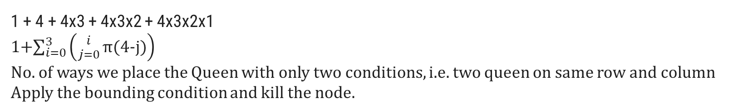
N - Queens State Space Tree
1
2
4
3
2
4
1
3
4
1
2
4
3
3
4
2
4
2
3
3
4
1
4
1
3
2
4
1
4
1
1
4
3
4
2
3
2
4
3
4
1
3
1
4
2
4
1
2
1
1 + 4 + 4x3 + 4x3x2 + 4x3x2x1
1+$\sum_{i=0}^{3}{\left({i \atop j=0}\text{π}\text{(4−}\text{j}\text{)}\right)}$
No. of ways we place the Queen with only two conditions, i.e. two queen on same row and column
Apply the bounding condition and kill the node.

Slide 13
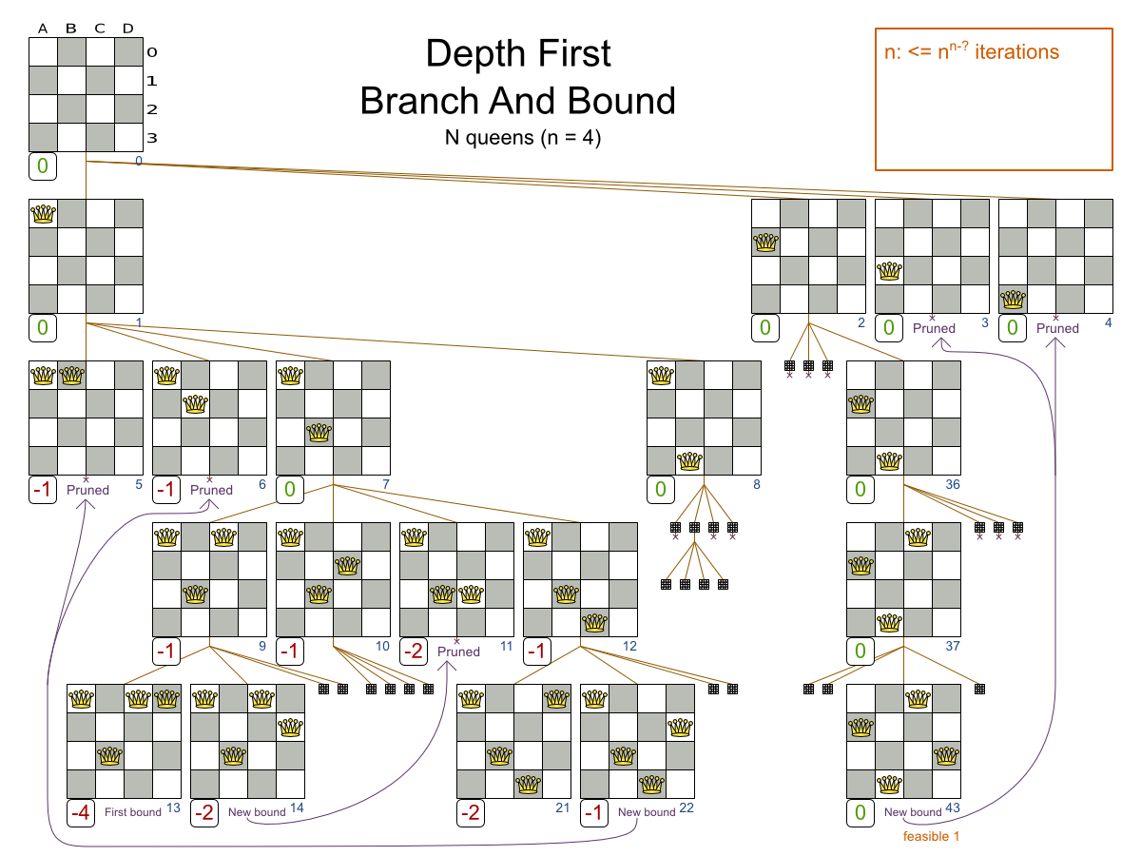

Slide 14
Knapsack Problem
We are given a certain number of objects and a knapsack.
Instead of supposing that we have n objects available, we shall suppose that we have n types of object, and that an adequate number of objects of each type are available.
Our aim is to fill the knapsack in a way that maximizes the value of the included objects.
We may take an object or leave behind, but we may not take fraction of an object.

Slide 15
Knapsack Problem – Cont…
Initially solution is empty.
Left of the semicolon are weights of selected objects.
Right of the semicolon is the current total value of load.
Weight of objects
w = (2,3,4,5)
Corresponding value of each object
v = (3,5,6,10)
Capacity of Knapsack
W = 8
Now, apply depth first search
; 0
2 ; 3
3 ; 5
4 ; 6
5 ; 10
2,2; 6
2,3; 8
2,4; 9
2,5; 13
3,3; 10
3,4; 11
3,5; 15
4,4; 12
2,2,2; 9
2,2,3; 11
2,2,4; 12
2,3,3; 13
Store solution if optimal solution is found
2,2,2,2; 12

Slide 16
Knapsack Problem – Algorithm
function backpack(i, r)
{Calculates the value of the best load that can be constructed using items of type i to n and whose total weight does not exceed r}
b ← 0
{Try each allowed kind of item in turn}
for k ← i to n do
if w[k] ≤ r then
b ← max(b, v[k] + backpack (k, r – w[k]))
return b

Slide 17
Minimax Algorithm
Minimax is a kind of backtracking algorithm that is used in decision making and game theory to find the optimal move for a player, assuming that your opponent also plays optimally.
Mini-Max algorithm uses recursion to search through the game-tree.
It is widely used in two player turn-based games such as Tic-Tac-Toe, Backgammon, Mancala, Chess, etc.
In this algorithm two players play the game, one is called MAX and other is called MIN.
Both the players fight it as the opponent player gets the minimum benefit while they get the maximum benefit.
Both Players of the game are opponent of each other, where MAX will select the maximized value and MIN will select the minimized value.
The minimax algorithm performs a depth-first search algorithm for the exploration of the complete game tree.
The minimax algorithm proceeds all the way down to the terminal node of the tree, then backtrack the tree as the recursion.

Slide 18
Minimax Principle
MAX (player)
3
MIN (opponent)
3
2
2
3
12
8
2
4
6
14
5
2

Slide 19
Working of MiniMax
The working of the minimax algorithm can be easily described using an example. Below we have taken an example of game-tree which is representing the two-player game.
In this example, there are two players one is called Maximizer and other is called Minimizer.
Maximizer will try to get the Maximum possible score, and Minimizer will try to get the minimum possible score.
This algorithm applies DFS, so in this game-tree, we have to go all the way through the leaves to reach the terminal nodes.
At the terminal node, the terminal values are given so we will compare those value and backtrack the tree until the initial state occurs.
let's take A is the initial state of the tree. Suppose maximizer takes first turn which has worst-case initial value =- infinity, and minimizer will take next turn which has worst-case initial value = +infinity.

Slide 20
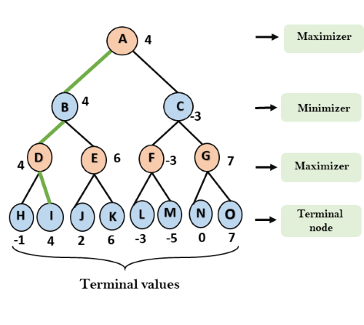
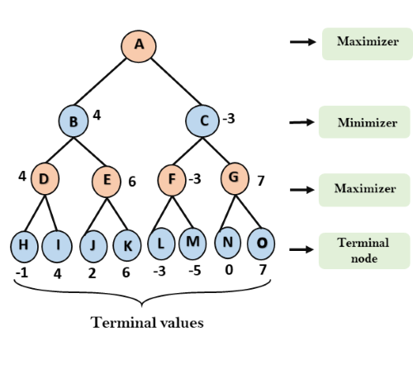
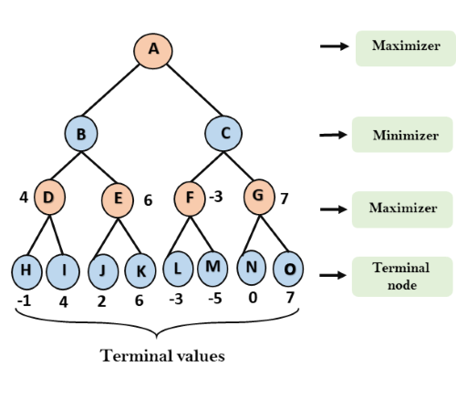
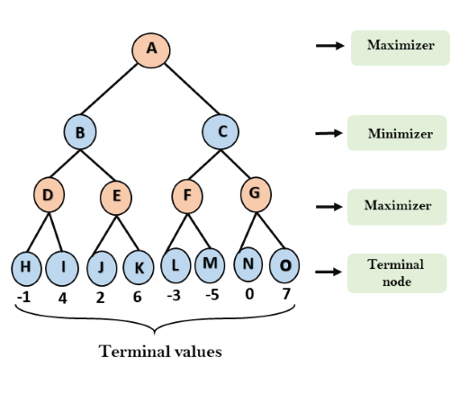

Slide 21
Pseudo-code
function minimax(node, depth, maximizingPlayer) is
if depth ==0 or node is a terminal node then
return static evaluation of node
if MaximizingPlayer then // for Maximizer Player
maxEva= -infinity
for each child of node do
eva= minimax(child, depth-1, false)
maxEva= max(maxEva,eva) //gives Maximum of the values
return maxEva
else // for Minimizer player
minEva= +infinity
for each child of node do
eva= minimax(child, depth-1, true)
minEva= min(minEva, eva) //gives minimum of the values
return minEva

Slide 22
Analysis
Time complexity- As it performs DFS for the game-tree, so the time complexity of Min-Max algorithm is O(b^{m}), where b is branching factor of the game-tree, and m is the maximum depth of the tree.
Space Complexity- Space complexity of Mini-max algorithm is also similar to DFS which is O(bm).

Slide 23
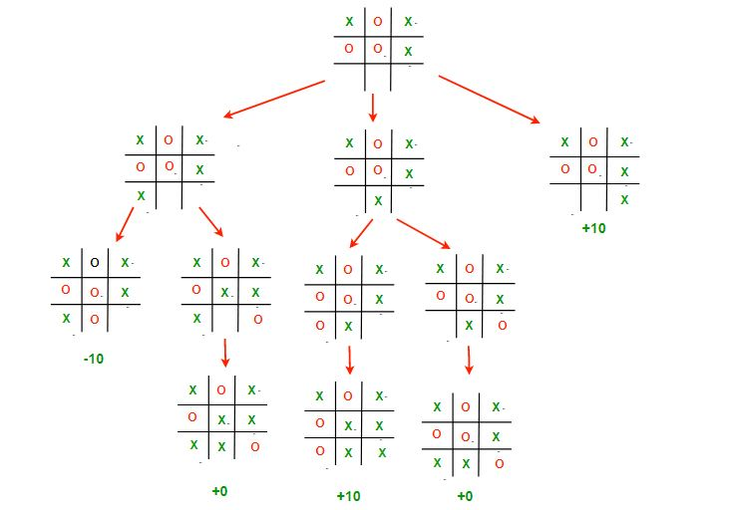
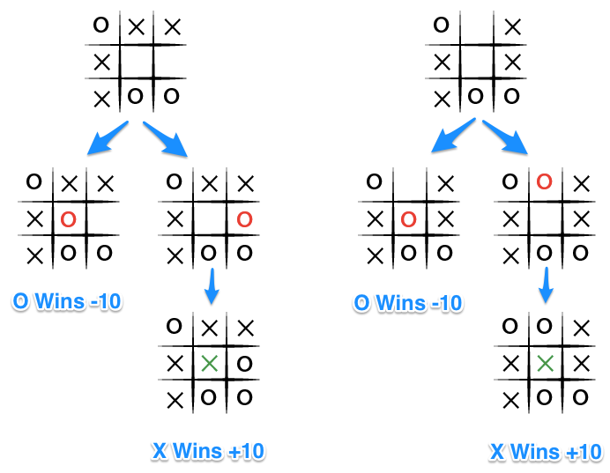
Minimax Principle
It is a decision rule that minimize the maximum loss and maximize the minimum profit(gain).

Slide 24
Minimax Principle
The key to the Minimax algorithm is a back and forth between the two players, where the player whose "turn it is" desires to select the move with the maximum score.
In turn, the scores for each of the available moves are determined by the opposing player deciding which of its available moves has the minimum score.
It uses a simple recursive computation of the minimax values of each successor state.
The recursion proceeds all the way down to the leaves of the tree, and then the minimax values are backed up through the tree as the recursion unwinds.

Slide 25
Minimax Principle – Cont…
X | X | O
X | O
 | O
Human
Max
WIN
X | X | O
X | O | X
 | O
X | X | O
X | O
X | O
X | X | O
X | O
 | O | X
Computer
Min
WIN
WIN
X | X | O
X | O | X
O | O
X | X | O
X | O | X
 | O | O
X | X | O
X | O
O | O | X
X | X | O
X | O | O
 | O | X
Human
Max
WIN
WIN
X | X | O
X | O | X
X | O | O
X | X | O
X | O | O
X | O | X
Computer
Min

Slide 26
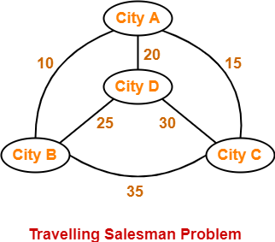
TSP
Travelling Salesman Problem states-
A salesman has to visit every city exactly once.
He has to come back to the city from where he starts his journey.
What is the shortest possible route that the salesman must follow to complete his tour?
The following graph shows a set of cities and distance between every pair of cities-

Slide 27
If salesman starting city is A, then a TSP tour in the graph is-
A → B → D → C → A
Cost of the tour
= 10 + 25 + 30 + 15
= 80 units

Slide 28
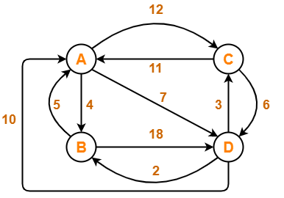
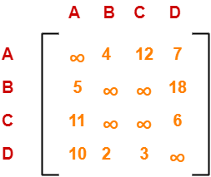
Problem:
Solve Travelling Salesman Problem using Branch and Bound Algorithm in the following graph-
Step-01:
Write the initial cost matrix and reduce it-

Slide 29
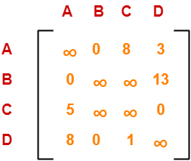
Rules
To reduce a matrix, perform the row reduction and column reduction of the matrix separately.
A row or a column is said to be reduced if it contains at least one entry ‘0’ in it.
Row Reduction-
Consider the rows of above matrix one by one.
If the row already contains an entry ‘0’, then-
There is no need to reduce that row.
If the row does not contains an entry ‘0’, then-
Reduce that particular row.
Select the least value element from that row.
Subtract that element from each element of that row.
This will create an entry ‘0’ in that row, thus reducing that row.
Following this, we have-
Reduce the elements of row-1 by 4.
Reduce the elements of row-2 by 5.
Reduce the elements of row-3 by 6.
Reduce the elements of row-4 by 2.
Performing this, we obtain the following row-reduced matrix-

Slide 30
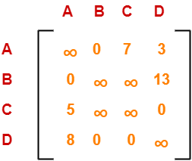
Column Reduction-
Consider the columns of above row-reduced matrix one by one.
If the column already contains an entry ‘0’, then-
There is no need to reduce that column.
If the column does not contains an entry ‘0’, then-
Reduce that particular column.
Select the least value element from that column.
Subtract that element from each element of that column.
This will create an entry ‘0’ in that column, thus reducing that column.
Following this, we have-
There is no need to reduce column-1.
There is no need to reduce column-2.
Reduce the elements of column-3 by 1.
There is no need to reduce column-4.
Performing this, we obtain the following column-reduced matrix-
Finally, the initial distance matrix is completely reduced.
Now, we calculate the cost of node-1 by adding all the reduction elements.
Cost(1)
= Sum of all reduction elements
= 4 + 5 + 6 + 2 + 1
= 18

Slide 31
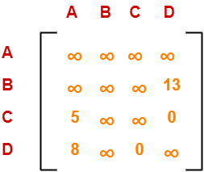

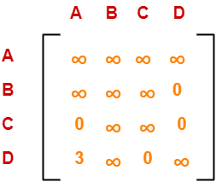
Step-02: We consider all other vertices one by one. We select the best vertex where we can land upon to minimize the tour cost.
Choosing To Go To Vertex-B: Node-2 (Path A → B)
From the reduced matrix of step-01, M[A,B] = 0
Set row-A and column-B to ∞
Set M[B,A] = ∞
Now, resulting cost matrix is-
We reduce this matrix.
Then, we find out the cost of node-02.
Cost(2)
= Cost(1) + Sum of reduction elements + M[A,B]
= 18 + (13 + 5) + 0
= 36
Column Reduction-
Reduce the elements of column-1 by 5.
We can not reduce column-2 as all its elements are ∞.
There is no need to reduce column-3.
There is no need to reduce column-4.
Row Reduction-
We can not reduce row-1 as all its elements are ∞.
Reduce all the elements of row-2 by 13.
There is no need to reduce row-3.
There is no need to reduce row-4.

Slide 32
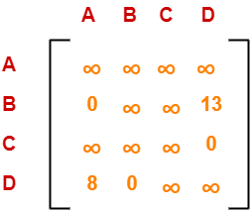
Choosing To Go To Vertex-C: Node-3 (Path A → C)
From the reduced matrix of step-01, M[A,C] = 7
Set row-A and column-C to ∞
Set M[C,A] = ∞
Now, resulting cost matrix is-
Cost(3)
= Cost(1) + Sum of reduction elements + M[A,C]
= 18 + 0 + 7
= 25
Row Reduction-
We can not reduce row-1 as all its elements are ∞.
There is no need to reduce row-2.
There is no need to reduce row-3.
There is no need to reduce row-4.
Thus, the matrix is already row-reduced.
Column Reduction-
There is no need to reduce column-1.
There is no need to reduce column-2.
We can not reduce column-3 as all its elements are ∞.
There is no need to reduce column-4.

Slide 33
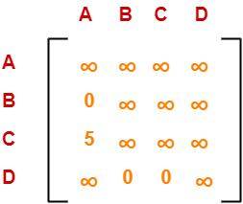
Choosing To Go To Vertex-D: Node-4 (Path A → D)
From the reduced matrix of step-01, M[A,D] = 3
Set row-A and column-D to ∞
Set M[D,A] = ∞
Now, resulting cost matrix is-
Cost(4)
= Cost(1) + Sum of reduction elements + M[A,D]
= 18 + 5 + 3
= 26
Row Reduction-
We can not reduce row-1 as all its elements are ∞.
There is no need to reduce row-2.
Reduce all the elements of row-3 by 5.
There is no need to reduce row-4.
Column Reduction-
There is no need to reduce column-1.
There is no need to reduce column-2.
There is no need to reduce column-3.
We can not reduce column-4 as all its elements are ∞.

Slide 34
Thus, we have-
Cost(2) = 36 (for Path A → B)
Cost(3) = 25 (for Path A → C)
Cost(4) = 26 (for Path A → D)
We choose the node with the lowest cost.
Since cost for node-3 is lowest, so we prefer to visit node-3.
Thus, we choose node-3 i.e. path A → C.

Slide 35
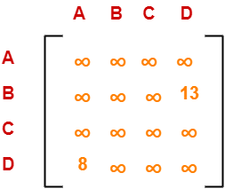
Step-03:
We explore the vertices B and D from node-3.
We now start from the cost matrix at node-3 which is-
Choosing To Go To Vertex-B: Node-5 (Path A → C → B)
From the reduced matrix of step-02, M[C,B] = ∞
Set row-C and column-B to ∞
Set M[B,A] = ∞
Now, resulting cost matrix is-
Cost(5)
= cost(3) + Sum of reduction elements + M[C,B]
= 25 + (13 + 8) + ∞
= ∞
Cost(3) = 25
Row Reduction-
We can not reduce row-1 as all its elements are ∞.
Reduce all the elements of row-2 by 13.
We can not reduce row-3 as all its elements are ∞.
Reduce all the elements of row-4 by 8.
Column Reduction-
There is no need to reduce column-1.
We can not reduce column-2 as all its elements are ∞.
We can not reduce column-3 as all its elements are ∞.
There is no need to reduce column-4.

Slide 36
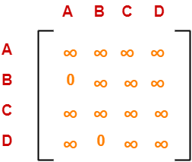
Choosing To Go To Vertex-D: Node-6 (Path A → C → D)
From the reduced matrix of step-02, M[C,D] = ∞
Set row-C and column-D to ∞
Set M[D,A] = ∞
Now, resulting cost matrix is-
Cost(6)
= cost(3) + Sum of reduction elements + M[C,D]
= 25 + 0 + 0
= 25
Row Reduction-
We can not reduce row-1 as all its elements are ∞.
There is no need to reduce row-2.
We can not reduce row-3 as all its elements are ∞.
We can not reduce row-4 as all its elements are ∞.
Column Reduction-
There is no need to reduce column-1.
We can not reduce column-2 as all its elements are ∞.
We can not reduce column-3 as all its elements are ∞.
We can not reduce column-4 as all its elements are ∞
Thus, we have-
Cost(5) = ∞ (for Path A → C → B)
Cost(6) = 25 (for Path A → C → D)
We choose the node with the lowest cost.
Since cost for node-6 is lowest, so we prefer to visit node-6.
Thus, we choose node-6 i.e. path C → D.

Slide 37
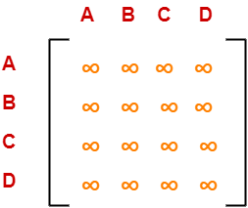
Step-04: We explore vertex B from node-6. We start with the cost matrix at node-6 which is-
Choosing To Go To Vertex-B: Node-7 (Path A → C → D → B)
From the reduced matrix of step-03, M[D,B] = 0
Set row-D and column-B to ∞
Set M[B,A] = ∞
Now, resulting cost matrix is-
Cost(6) = 25
Thus, the matrix is already column reduced: column and row reduced.
Cost(7)
= cost(6) + Sum of reduction elements + M[D,B]
= 25 + 0 + 0
= 25
Thus,
Optimal path is: A → C → D → B → A
Cost of Optimal path = 25 units

Slide 38
Disjoint Set Data structure
The disjoint set data structure is also known as union-find data structure and merge-find set. It is a data structure that contains a collection of disjoint or non-overlapping sets.
The disjoint set means that when the set is partitioned into the disjoint subsets. The various operations can be performed on the disjoint subsets.
In this case, we can add new sets, we can merge the sets, and we can also find the representative member of a set. It also allows to find out whether the two elements are in the same set or not efficiently.
The disjoint set can be defined as the subsets where there is no common element between the two sets. Let's understand the disjoint sets through an example

Slide 39
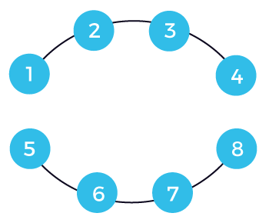
We have two subsets named s1 and s2. The s1 subset contains the elements 1, 2, 3, 4, while s2 contains the elements 5, 6, 7, 8. Since there is no common element between these two sets, we will not get anything if we consider the intersection between these two sets. This is also known as a disjoint set where no elements are common. Now the question arises how we can perform the operations on them. We can perform only two operations, i.e., find and union.
s1 = {1, 2, 3, 4}
s2 = {5, 6, 7, 8}

Slide 40
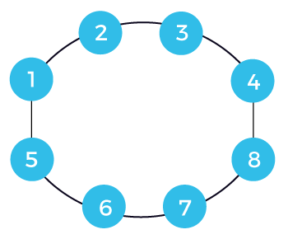
In the case of find operation, we have to check that the element is present in which set. There are two sets named s1 and s2 shown below:
Suppose we want to perform the union operation on these two sets. First, we have to check whether the elements on which we are performing the union operation belong to different or same sets. If they belong to the different sets, then we can perform the union operation; otherwise, not. For example, we want to perform the union operation between 4 and 8. Since 4 and 8 belong to different sets, so we apply the union operation. Once the union operation is performed, the edge will be added between the 4 and 8 shown as below:
When the union operation is applied, the set would be represented as:
s1U s2 = {1, 2, 3, 4, 5, 6, 7, 8}
Suppose we add one more edge between 1 and 5. Now the final set can be represented as:
s3 = {1, 2, 3, 4, 5, 6, 7, 8}
If we consider any element from the above set, then all the elements belong to the same set; it means that the cycle exists in a graph.

Slide 41
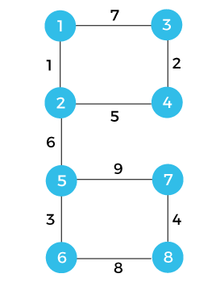
How can we detect a cycle in a graph?
We will understand this concept through an example. Consider the below example to detect a cycle with the help of using disjoint sets.
U = {1, 2, 3, 4, 5, 6, 7, 8}
Each vertex is labelled with some weight. There is a universal set with 8 vertices. We will consider each edge one by one and form the sets.
First, we consider vertices 1 and 2. Both belong to the universal set; we perform the union operation between elements 1 and 2. We will add the elements 1 and 2 in a set s1 and remove these two elements from the universal set shown below:
s1 = {1, 2}
The vertices that we consider now are 3 and 4. Both the vertices belong to the universal set; we perform the union operation between elements 3 and 4. We will form the set s3 having elements 3 and 4 and remove the elements from the universal set shown as below:
s2 = {3, 4}
The vertices that we consider now are 5 and 6. Both the vertices belong to the universal set, so we perform the union operation between elements 5 and 6. We will form the set s3 having elements 5 and 6 and will remove these elements from the universal set shown as below:
s3 = {5, 6}
The vertices that we consider now are 7 and 8. Both the vertices belong to the universal set, so we perform the union operation between elements 7 and 8. We will form the set s4 having elements 7 and 8 and will remove these elements from the universal set shown as below:
s4 = {7, 8}

Slide 42
The next edge that we take is (2, 4). The vertex 2 is in set 1, and vertex 4 is in set 2, so both the vertices are in different sets. When we apply the union operation, then it will form the new set shown as below:
s5 = {1, 2, 3, 4}
The next edge that we consider is (2, 5). The vertex 2 is in set 5, and the vertex 5 is in set s3, so both the vertices are in different sets. When we apply the union operation, then it will form the new set shown as below:
s6 = {1, 2, 3, 4, 5, 6}
Now, two sets are left which are given below:
s4 = {7, 8}
s6 = {1, 2, 3, 4, 5, 6}
The next edge is (1, 3). Since both the vertices, i.e.,1 and 3 belong to the same set, so it forms a cycle. We will not consider this vertex.
The next edge is (6, 8). Since both vertices 6 and 8 belong to the different vertices s4 and s6, we will perform the union operation. The union operation will form the new set shown as below:
s7 = {1, 2, 3, 4, 5, 6, 7, 8}
The last edge is left, which is (5, 7). Since both the vertices belong to the same set named s7, a cycle is formed.

Slide 43
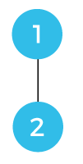
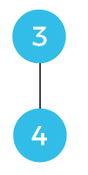
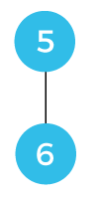
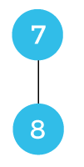
How can we represent the sets graphically?
We have a universal set which is given below:
U = {1, 2, 3, 4, 5, 6, 7, 8}
We will consider each edge one by one to represent graphically.
First, we consider the vertices 1 and 2, i.e., (1, 2) and represent them through graphically shown as below:
In the above figure, vertex 1 is the parent of vertex 2.
Now we consider the vertices 3 and 4, i.e., (3, 4) and represent them graphically shown as below:
In the above figure, vertex 3 is the parent of vertex 4.
Consider the vertices 5 and 6, i.e., (5, 6) and represent them graphically shown as below:
In the above figure, vertex 5 is the parent of vertex 6.
Now, we consider the vertices 7 and 8, i.e., (7, 8) and represent them through graphically shown as below:

Slide 44
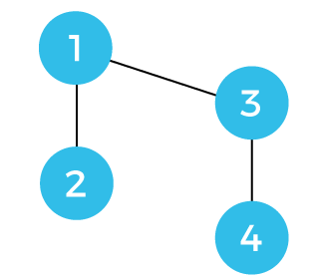
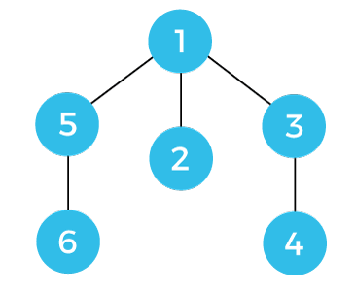
Now we consider the edge (2, 4). Since 2 and 4 belong to different sets, so we need to perform the union operation. In the above case, we observe that 1 is the parent of vertex 2 whereas vertex 3 is the parent of vertex 4. When we perform the union operation on the two sets, i.e., s1 and s2, then 1 vertex would be the parent of vertex 3 shown as below:
The next edge is (2, 5) having weight 6. Since 2 and 5 are in two different sets so we will perform the union operation. We make vertex 5 as a child of the vertex 1 shown as below:
We have chosen vertex 5 as a child of vertex 1 because the vertex of the graph having parent 1 is more than the graph having parent 5.
The next edge is (1, 3) having weight 7. Both vertices 1 and 3 are in the same set, so there is no need to perform any union operation. Since both the vertices belong to the same set; therefore, there is a cycle. We have detected a cycle, so we will consider the edges further.

